Slide 1
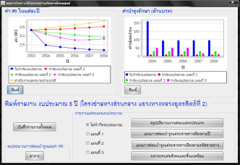
HRIS
Roadnet
CRDB
Standalone
TIMS

Slide 2
HRIS
Roadnet
TPMS ๒๐๑๖
TIMS
MIIS

