Slide 1
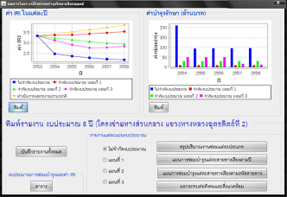
HRIS
Roadnet
CRDB
Standalone
TIMS

Slide 2
HRIS
Roadnet
TPMS 2016
TIMS
MIIS

